Slide 1
wide & deep networks

Slide 2
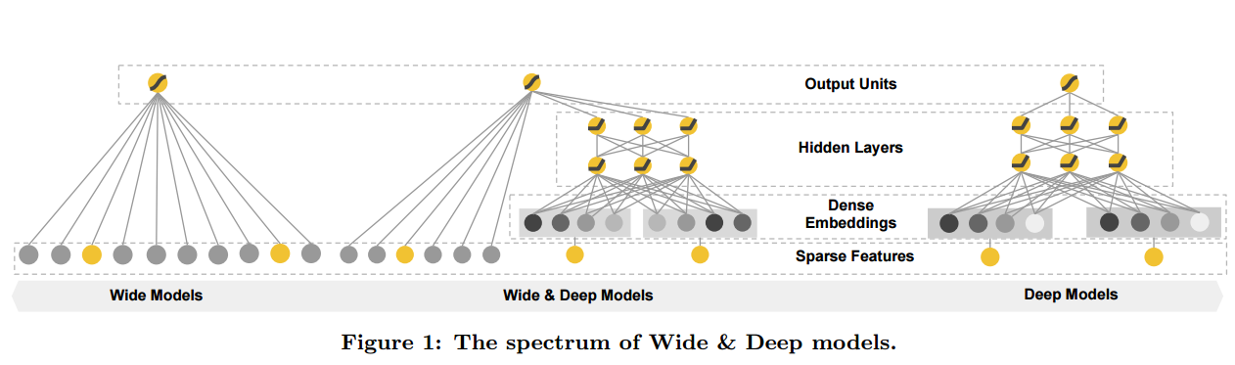
Model Architecture

Slide 3

Motivation: what problems it comes to solve
Recomandation systems
  Memorization: exploiting the correlation available in the historical data
  sparse and high-rank
  cross-product feature transformations
  The Wide Component:
    y = wx + b

Slide 4

Recommendation systems
  Generalization: new feature combinations that have never or rarely occurred in the past
  The Deep Component:
    high-dimensional categorical features are first converted into a low-dimensional and dense real-valued vector, often referred to as an embedding vector

Slide 5
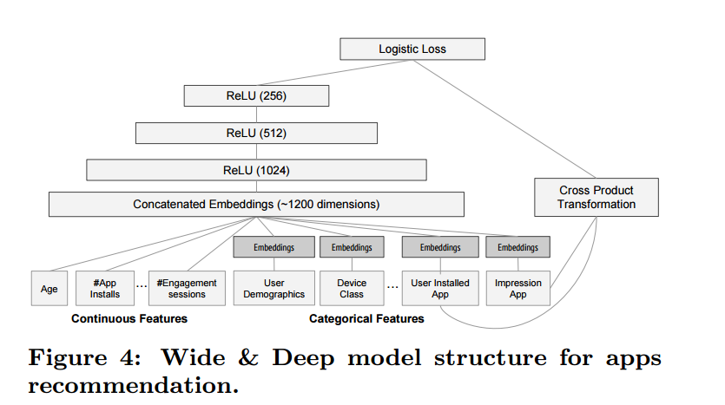
Joint training

Slide 6
Experiment
Follow the-regularized-leader (FTRL) algorithm with L1 regularization as the optimizer for the wide part of the model, and AdaGrad for the deep part

Slide 7
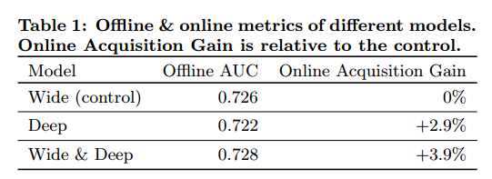
EXPERIMENT RESULTS
For the control group, 1% of users were randomly selected and presented with recommendations generated by the previous version of ranking model, which is a highly-optimized wide-only logistic regression model with rich cross-product feature transformations. For the experiment group, 1% of users were presented with recommendations generated by the Wide & Deep model, trained with the same set of features

Slide 8
How can we use it?
- Add generalization to linear models by factorizing the interactions between two variables.
- Reduce the difficulty of training deeper models and
improve accuracy
- Example (didn’t try it):
BMI,Age - as Wide, the rest - as deep
low dim vectors: hour of the day as wide

Slide 9
Implementation in Keras
wide = Sequential()
wide.add(Dense(1, input_dim=X_train.shape[1]))
deep = Sequential()
# TODO: add embedding
deep.add(Dense(input_dim=X_train.shape[1], output_dim=100, activation='relu'))
deep.add(Dense(100, activation='relu'))
deep.add(Dense(50, activation='relu'))
deep.add(Dense(1, activation='sigmoid'))
model = Sequential()
model.add(Merge([wide, deep], mode='concat', concat_axis=1))
model.add(Dense(1, activation='sigmoid'))

